Slide 1
Distributional Similarity

Slide 2
Problems with thesaurus-based meaning
We don’t have a thesaurus for every language
Even if we do, they have problems with recall
Many words are missing
Most (if not all) phrases are missing
Some connections between senses are missing
Thesauri work less well for verbs, adjectives
Adjectives and verbs have less structured hyponymy relations

Slide 3
Distributional models of meaning
Also called vector-space models of meaning
Offer much higher recall than hand-built thesauri
Although they tend to have lower precision
Also called vector-space models of meaning
Offer much higher recall than hand-built thesauri
Although they tend to have lower precision
Zellig Harris (1954): “oculist and eye-doctor … occur in almost the same environments…. If A and B have almost identical environments we say that they are synonyms.
Firth (1957): “You shall know a word by the company it keeps!”

Slide 4
Intuition of distributional word similarity
Nida example:
A bottle of tesgüino is on the table
Everybody likes tesgüino
Tesgüino makes you drunk
We make tesgüino out of corn.
From context words humans can guess tesgüino means
an alcoholic beverage like beer
Intuition for algorithm:
Two words are similar if they have similar word contexts.

Slide 5
Reminder: Term-document matrix
Each cell: count of term t in a document d: tf_{t,d}:
Each document is a count vector in ℕ^{v}: a column below

Slide 6
Reminder: Term-document matrix
Two documents are similar if their vectors are similar

Slide 7
The words in a term-document matrix
Each word is a count vector in ℕ^{D}: a row below

Slide 8
The words in a term-document matrix
Two words are similar if their vectors are similar

Slide 9
The Term-Context matrix
Instead of using entire documents, use smaller contexts
Paragraph
Window of 10 words
A word is now defined by a vector over counts of context words

Slide 10
Sample contexts: 20 words (Brown corpus)
equal amount of sugar, a sliced lemon, a tablespoonful of apricot preserve or jam, a pinch each of clove and nutmeg,
on board for their enjoyment. Cautiously she sampled her first pineapple and another fruit whose taste she likened to that of
of a recursive type well suited to programming on the digital computer. In finding the optimal R-stage policy from that of
substantially affect commerce, for the purpose of gathering data and information necessary for the study authorized in the first section of this

Slide 11
Term-context matrix for word similarity
Two words are similar in meaning if their context vectors are similar

Slide 12
Should we use raw counts?
Raw word frequency is not a great measure of association between words
It’s very skewed
“the” and “of” are very frequent, but maybe not the most discriminative
We’d rather have a measure that asks whether a context word is particularly informative about the target word.

Slide 13
Should we use raw counts?
For the term-document matrix
We used tf-idf instead of raw term counts
For the term-context matrix
Positive Pointwise Mutual Information (PPMI) is common

Slide 14
Term frequency (tf)
tf_{t,d} = count(t,d)
Instead of using raw count, we squash a bit:
tf_{t,d} = log₁₀(count(t,d)+1)
Notes:
The tf-idf algorithm (the ‘-’ here is a hyphen, not a minus sign) is the product of two terms, each term capturing one of these two intuitions. The first is the term frequency: the frequency of the word t in the document d. We can just use the raw count as the term frequency: EQ
More commonly we squash the raw frequency a bit, by using the log10 of the fre- quency instead. The intuition is that a word appearing 100 times in a document doesn’t make that word 100 times more likely to be relevant to the meaning of the document. Because we can’t take the log of 0, we normally add 1 to the count:

Slide 15
Document frequency (df)
df_{t} is the number of documents t occurs in.
(note this is not collection frequency: total count across all documents)
"Romeo" is very distinctive for one Shakespeare play:
Notes:
The second factor in tf-idf is used to give a higher weight to words that occur only in a few documents. Terms that are limited to a few documents are useful for discriminating those documents from the rest of the collection; terms that occur frequently across the entire collection aren’t as helpful. The document frequency dft of a term t is the number of documents it occurs in .
Document frequency is not the same as the collection frequency of a term, which is the total number of times the word appears in the whole collection in any document. Consider in the collection of Shakespeare’s 37 plays the two words Romeo and action. The words have identical collection frequencies (they both occur 113 times in all the plays) but very different document frequencies, since Romeo only occurs in a single play. If our goal is to find documents about the romantic tribulations of Romeo, the word Romeo should be highly weighted, but not action:
Important: documents can be anything, they don't have to be original documents. For example we often treat each paragraph as a document, which lets use compute tf-idf values for

Slide 16
Inverse document frequency (idf)
N is the total number of documents
in the collection
Notes:
We emphasize discriminative words like Romeo via the inverse document fre- quency or idf term weight (Sparck Jones, 1972). The idf is defined using the frac- tion N/dft, where N is the total number of documents in the collection, and dft is the number of documents in which term t occurs. The fewer documents in which a term occurs, the higher this weight. The lowest weight of 1 is assigned to terms that occur in all the documents. Because of the large number of documents in many collections, this measure too is usually squashed with a log function. The resulting definition for inverse document frequency (idf) is thus
Here are some idf values for some words in the Shakespeare corpus, ranging from extremely informative words which occur in only one play like Romeo, to those that occur in a few like salad or Falstaff, to those which are very common like fool or so common as to be completely non-discriminative since they occur in all 37 plays like good or sweet.

Slide 17
What is a document?
Could be a play or a Wikipedia article
But for the purposes of tf-idf, documents can be anything; we often call each paragraph a document!
Notes:
It’s usually clear what counts as a document: in Shake-speare we would use a play; when processing a collection of encyclopedia articles like Wikipedia, the document is a Wikipedia page; in processing newspaper articles, the document is a single article. But very frequently you might need to break up the corpus into documents yourself for the purposes of computing idf. Because that documents can be anything, they don't have to be original documents. For example we often treat each paragraph as a document, which lets use compute tf-idf values even when we are dealing say with a single document like a book.

Slide 18
Final tf-idf weighted value for a word
Raw counts:
tf-idf:
Notes:
The tf-idf weighted value wt,d for word t in document d thus combines term
frequency tft,d with idf:
Here's the raw counts in the Shakespeare term-document matrix, and the tf-idf weighted version of the same matrix.. Note that the tf-idf values for the dimension corresponding to the word good have now all become 0; since this word appears in every document, the tf-idf algorithm leads it to be ignored. Similarly, the word fool, which appears in 36 out of the 37 plays, has a much lower weight.

Slide 19
Pointwise Mutual Information
Pointwise mutual information:
Do events x and y co-occur more than if they were independent?
PMI between two words: (Church & Hanks 1989)
Do words x and y co-occur more than if they were independent?
Positive PMI between two words (Niwa & Nitta 1994)
Replace all PMI values less than 0 with zero

Slide 20
Computing PPMI on a term-context matrix
Matrix F with W rows (words) and C columns (contexts)
f_{ij} is # of times w_{i} occurs in context c_{j}

Slide 21
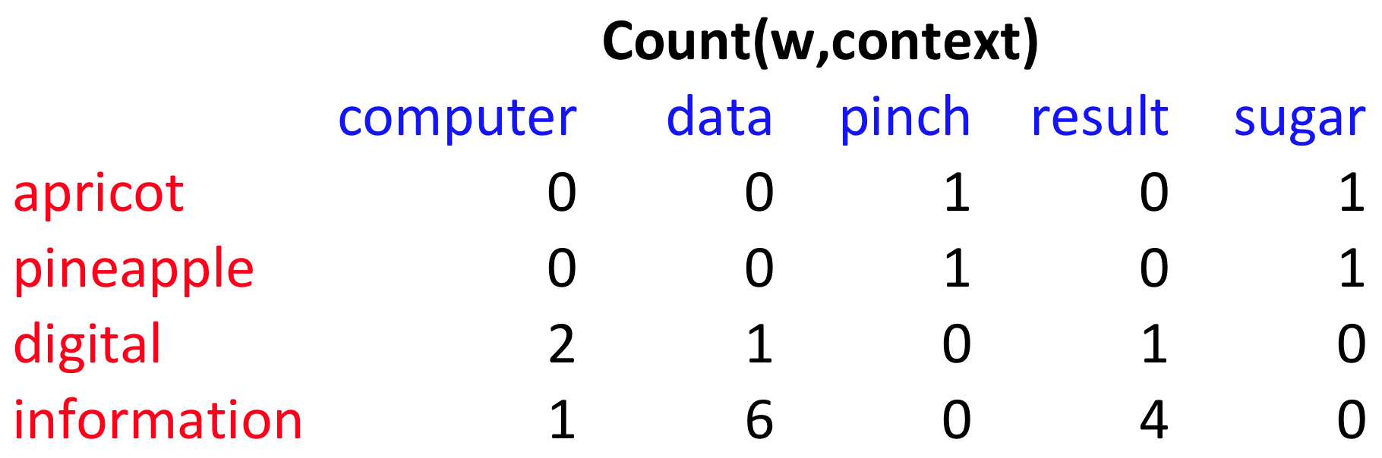
p(w=information,c=data) =
p(w=information) =
p(c=data) =
6/19
= .32
11/19
= .58
7/19
= .37

Slide 22
pmi(information,data) = log₂ (
.32 /
(.37*.58) )
= .58
(.57 using full precision)

Slide 23
Weighing PMI
PMI is biased toward infrequent events
Various weighting schemes help alleviate this
See Turney and Pantel (2010)
Add-one smoothing can also help

Slide 26
Using syntax to define a word’s context
Zellig Harris (1968)
“The meaning of entities, and the meaning of grammatical relations among them, is related to the restriction of combinations of these entities relative to other entities”
Two words are similar if they have similar parse contexts
Duty and responsibility (Chris Callison-Burch’s example)
Modified by adjectives | additional, administrative, assumed, collective, congressional, constitutional …
Objects of verbs | assert, assign, assume, attend to, avoid, become, breach …

Slide 27
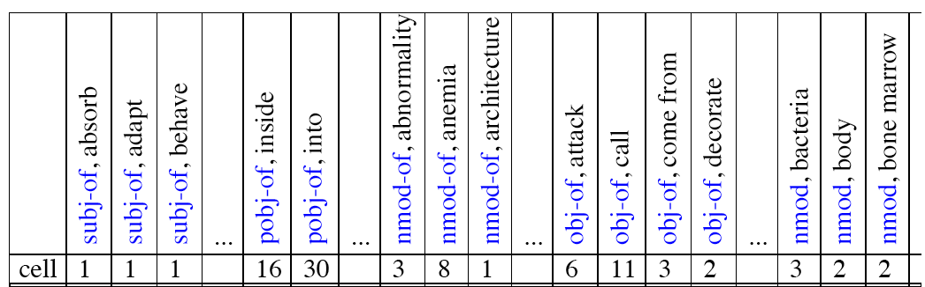
Co-occurrence vectors based on syntactic dependencies
Dekang Lin, 1998 “Automatic Retrieval and Clustering of Similar Words”
The contexts C are different dependency relations
Subject-of- “absorb”
Prepositional-object of “inside”
Counts for the word cell:

Slide 28
PMI applied to dependency relations
Hindle, Don. 1990. Noun Classification from Predicate-Argument Structure. ACL
Object of “drink” | Count | PMI
it | 3 | 1.3
anything | 3 | 5.2
wine | 2 | 9.3
tea | 2 | 11.8
liquid | 2 | 10.5
Object of “drink” | Count | PMI
tea | 2 | 11.8
liquid | 2 | 10.5
wine | 2 | 9.3
anything | 3 | 5.2
it | 3 | 1.3
“Drink it” more common than “drink wine”
But “wine” is a better “drinkable” thing than “it”

Slide 29
Measuring similarity
Given 2 target words v and w
We’ll need a way to measure their similarity.
Most measure of vectors similarity are based on the:
Dot product or inner product from linear algebra
High when two vectors have large values in same dimensions.
Low (in fact 0) for orthogonal vectors with zeros in complementary distribution

Slide 30
Problem with dot product
Dot product is longer if the vector is longer. Vector length:
Vectors are longer if they have higher values in each dimension
That means more frequent words will have higher dot products
That’s bad: we don’t want a similarity metric to be sensitive to word frequency

Slide 31
Reminder: cosine for computing similarity
Sec. 6.3
Dot product
Unit vectors
v_{i} is the PPMI value for word v in context i
w_{i} is the PPMI value for word w in context i.
Cos(v,w) is the cosine similarity of v and w
Notes:
See Law of Cosines (Cosine Rule) wikipedia page

Slide 32

Cosine as a similarity metric
-1: vectors point in opposite directions
+1: vectors point in same directions
0: vectors are orthogonal
Raw frequency or PPMI are non-negative, so cosine range 0-1

Slide 33
 | large | data | computer
apricot | 1 | 0 | 0
digital | 0 | 1 | 2
information | 1 | 6 | 1
Which pair of words is more similar?
cosine(apricot,information) =
cosine(digital,information) =
cosine(apricot,digital) =

Slide 34
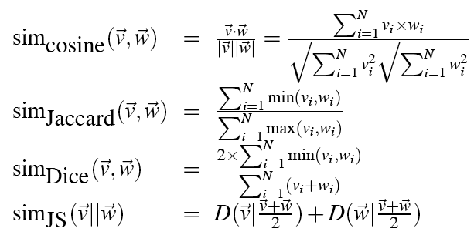
Other possible similarity measures

Slide 35
Evaluating similarity (the same as for thesaurus-based)
Intrinsic Evaluation:
Correlation between algorithm and human word similarity ratings
Extrinsic (task-based, end-to-end) Evaluation:
Spelling error detection, WSD, essay grading
Taking TOEFL multiple-choice vocabulary tests
Levied is closest in meaning to which of these:
imposed, believed, requested, correlated

